Slide 1
Multimedia Information Systems
Dereje Teferi
dereje.teferi@aau.edu.et

Slide 2
Why Multimedia?
Existence of wide variety of application potential in different areas
Huge markets
Potential for improving our lives (e.g., learning, entertainment, and work)
Convergence of computers, telecom, and TV industries
Caused by technology and competition
Dramatic changes in products, infrastructure, etc.
Digital Audio and Digital Video are revolutionizing music, film, and video industries
It helps to simulate our day-to-day activities
Collaboration: video conferencing, tele-conferencing
virtual environments: (e-commerce, e-education, …)
webcasting
Interesting technical and research issues
There are many challenges which needs further investigation

Slide 3
Course Outline
Topic | Contents
Introduction | Overview of Multimedia and Multimedia Systems; Types of Multimedia; Why Multimedia; Challenges in Multimedia
Multimedia Basics & Representation | Digital multimedia Characteristics; Audio Formats & MIDI; Image Formats & Color Models; Video Formats & Color Models
Multimedia Data Compression | Overview compression; Compression with Loss and Lossless; Static Coding: Huffman & Entropy; Adaptive Coding: LZW
Mid Exam
Multimedia Storage | Basics of Optical Storage; Technological progress of Compact Disc (CD); Digital Video/Versatile Disc (DVD)
Multimedia Database Management | Representation of multimedia data; Matching & Similarity Measurement; Issues in Indexing & Searching; Retrieval Performance Measures; Query Languages; Relevance Feedback and Query Expansion
Final Exam

Slide 4
Reading Materials
Ralf Steinmetz and Klara Nahrstedt, Multimedia Fundamentals: Media Coding and Content Processing; Pearson Education, 2004.
V. S. Subrahmanian, Principles of Multimedia Database Systems, USA: Morgan Kaufmann Publishers, 1998.
William I. Grosky, Ramesh Jain, Rajiv Mehrotra (Eds.): Handbook of Multimedia Information Management. Prentice-Hall 1997.
V. S. Subrahmanian, and S. K. Tripathi, Multimedia Information Systems, Springer London, Limited, 1998.
C. Faloutsos, Searching Multimedia Databases by Content, Norwell, MA: Kluwer Academic Publisher, 1996.
Christos Faloutsos, Searching Multimedia by Content, Kluwer Academic Publishers, 1996.
Peter M. G. Apers, Henk M. Blanken, Maurice A. W. Houtsma (Eds.): Multimedia Databases in Perspective. Springer 1997.
Kingsley C. Nwosu, Bhavani M. Thuraisingham, P. Bruce Berra (Eds.): Multimedia Database Systems: Design and Implementation Strategies. Kluwer Academic Publishers, 1996.
Andleigh, Prabhat K., and Thakrar, Kiran, Multimedia Systems Design, Prentice Hall,1995.

Slide 5
What is Multimedia?
Multimedia is a way of conveying information or entertainment through multiple forms of media.
It can include text, graphics, audio, video, and animation. Multimedia can be experienced on various devices, such as computers, smartphones, televisions, and gaming consoles.
Multimedia is used exclusively to describe multiple forms of media and content.
Multimedia concerns the representation of mixed modes of information as digital signals.
It includes a combination of text, audio and speech, video, images and graphics content forms
Multimedia represents the convergence of text, image, video and sound into a single form.
The power of multimedia and the Internet lies in the way in which information is linked.

Slide 6
Media Types: Two broad classes
Discrete (or Static) media: it refers to text, graphics, and images as they are composed of time independent information item.
Information in these media consist exclusively of a sequence of individual elements without a time component. Indeed they may be displayed according to a wide variety of timing or even sequencing and still remain meaningful

Slide 7
Continuous media
Continuous (or Dynamic) media: refers to time-dependent media like sound, and video, where the presentation requires a continuous play-out as time passes.
Information is expressed as not only of its individual value, but also by the time of its occurrence. In other words, time dependency between information items is part of the information itself.
Thus if the timing of the items change, or the sequence is modified, the meaning of the items is altered.
Note: These notions of time-dependent, discrete and continuous media do not have any connection to the internal representation.

Slide 8
Multimedia System
Multimedia system represents a technology/tool used to combine two or more categories of information having different transport signal characteristics.
Examples of media: Image, audio, video, text and graphics
Discuss:
Can we say a word processor that handles embedded graphics/image in addition to text a multimedia system?
What about macromedia flash that helps to create animated objects?
Do you think PDF, PS and DAT files are multimedia?

Slide 9
Properties of Multimedia System
Multimedia system handles discrete & continuous media
It is a system capable of handling at least one discrete and one continuous media in digital form
E.g. Multiple forms of information content are often not considered multimedia if they don't contain, say, audio or video.
integrates and synchronizes the different medias simultaneously into a coherent framework.
integrate and use minimal number of different devices for presentation of multimedia
Synchronize well the presentation of the result of the different media such that information flows in the correct order
Multimedia system must be computer controlled.
A digital device, like computer must be involved in the presentation of the multimedia information to users

Slide 10
Application
Multimedia finds its application in various areas with the help of Web technologies
Education: hypermedia courseware, e-learning, audio/video conferencing
Business: e.g. multimedia authoring, video-on-demand
Digital and virtual libraries
Entertainment: e.g. games
Advertisements: e.g. interactive television
Scientific research: e.g. virtual worlds
Engineering: e.g. AutoCAD
Art, Medicine, Mathematics, etc.

Slide 11



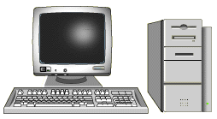
A Course-on-Demand System
On-line facilitator
Courseware
developer
Network
Multimedia
Database
Database server
user

Slide 12
Challenges of Multimedia Computing
Developing a successful multimedia system is non-trivial.
Memory space requirement: multimedia data need a lot of space to store
At least GB’s main memory; Up to TB’s secondary storage; PB’s of tertiary storage
Data transmission bandwidth: Multimedia needs very high bandwidth to transmit.
Faster network (up to 25Mbs per video stream) with very high bandwidth to transmit

Slide 13
Challenges of Multimedia Computing
Complexity of multimedia data management: Multimedia needs more complex and more efficient algorithms
Automatically analyzing, indexing and organizing information in audio, image and video is much harder than from text.
Hardware platforms: Multimedia data need efficient hardware platforms
Better CPU, GPU: graphics card, video card, sound card

Slide 14
Multimedia is a Multidisciplinary subject
Operating system, Computer
networks
Image, audio, speech processing
Multimedia
computing
Computer vision,
pattern recognition
Computer
graphics
Human-computer
interaction

Slide 15
Multimedia Computing
It involves extensive practices from multimedia capturing, processing, transmitting, content representing to multimedia database management
Multimedia systems involve multimedia information handling and some basic enabling techniques:
Multimedia Data Generation: production/authoring tools
Software Authoring Tools: e.g., Adobe flash, MS silver light, Macromedia, etc.
For Web publishing: HTML, Java, Macromedia Director, etc.
Multimedia Data Representation: compression and formats
Storage and file systems design
Multimedia Database Management: Multimedia Data Processing and Analysis, indexing, searching and retrieval.
Multimedia Data Transmission through communication and computer networks.

Slide 16
Digital Audio, Image and Video

Slide 17
Overview
Audio: used to record sound.
In the past 20 years, audio has moved from analog recording on tape cassettes to totally digital recording using computers.
Today, the Musical Instrument Digital Interface (MIDI) allow anyone to create music right on their desktop. MIDI is a digital standard that defines how to code musical scores, such as sequences of notes, timing conditions, and the instrument to play each note.
Image:
It is a 2-D object, which is stored as a specific arrangement of dots, or pixels.
It differs from graphics in that images can be captured from the real world, where as graphics are created by software & internally represented as an assemblage of primitive objects such as lines, curves, circles, polygons, and arcs.
Unlike Images, graphics are usually editable or revisable.
Video:
A series of framed images put together, one after another, to simulate motion and interactivity. A video can be transmitted by number of frames per second and/or the amount of time between switching frames.
The difference between video and animation is that video is broken down into individual frames.
Notes:
In film and video, footage is the raw, unedited material as it had been originally recorded by video camera, which usually must be edited to create a motion picture, video clip, television show or similar completed work.

Slide 18
Digital Media
In computers, audio, image and video are stored as files just like other text files (e.g. DOC, TXT, TEX, etc.).
For images, these files can have an extension like
BMP, JPG/JPEG, GIF, TIF, PNG, PPM, …
For audios, the file extensions include
WAV, MP3, m4a, AMR, WMA…
The videos files usually have extensions:
MOV, AVI, MPEG, MP4, 3gp, …
What about PDF file? PS file? DAT file?

Slide 19

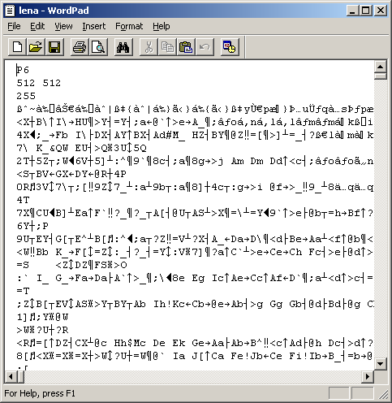
Digital Image Example
Let’s open an image file: its “raw” format:
P6: (this is a ppm image)
Resolution: 512x512 pixels
Depth: 255 (0-255: 8 bits per pixel in each channel, 2⁸=256)

Slide 20
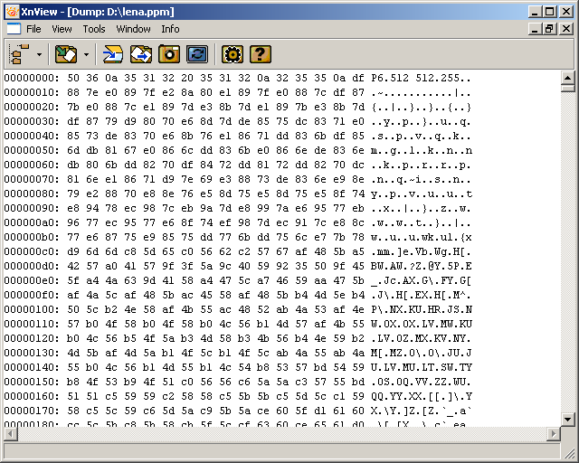
Image content
An image
contains
a header and
a bunch of
(integer) numbers that describe the color or intensity in gray scale images.

Slide 21
Digital Media Capturing
To get a digital image, an audio or a video clip, we need some media capturing devices
Image:
is captured using devises such as a digital camera or a digital scanner
Audio:
is recorded using a digital audio recorder (or Microphone), such as Mobile Voice Recorder, MP3 digital recorder, etc.
Video:
is recorded using a digital camcorder.
Camcorder (camera and recorder) is a video camera that records video and audio using a built-in recorder unit. The camcorder contains both a video camera and a video recorder in one unit and hence its compound name

Slide 22
Advantage of digital media over analog
Does digital cameras do things that are not done by still cameras?
The following are some of the advantages of digital media
Displaying images/audios/videos on a screen immediately after they are recorded
Storing thousands of images/audios/videos on a single small memory device
Deleting images/audios/videos to free storage space
Digital camera enables recording video with sound; and camcorder enables capturing image.
What else?

Slide 23
Convert Analog to Digital Media
Once the media is captured, there is a need to process them to convert the continuous signal to digital.
Hence, all the devices used for capturing the digital media have to complete the following tasks:
Sampling: converts a continuous media (analog signal) into a discrete set of values at regular time and/or space intervals.
Given an analog media, sampling represents a mapping of the media from a continuum of points in space (and possibly time, if it is a moving image) to a discrete set.

Slide 24
Convert Analog to Digital …
Digitization/quantization: converts a sampled signal into a signal that can take only a limited number of values (or bit depth).
E.g. an 8-bit quantization provides 256 possible values
Compression: There are probably some further compression process to reduce file size to save space.
Compression is minimizing the size in bytes of a media file without degrading the quality too much.

Slide 25
Sampling vs. Digitization/Quantization
The samples are continuous and have infinite number of possible values at every sampled points (at regular time interval and/or space).
The digitization/quantization process approximates the bit depth with a fixed number of values.
To represent N numbers, we need log₂^{N} bits.
For example, an 8 bit quantization represents 256 possible values.
What about a 16 bit quantization? It handles more than 65,000 possible values
So, what determines the number of bits we need for an audio clip or an image?

Slide 26
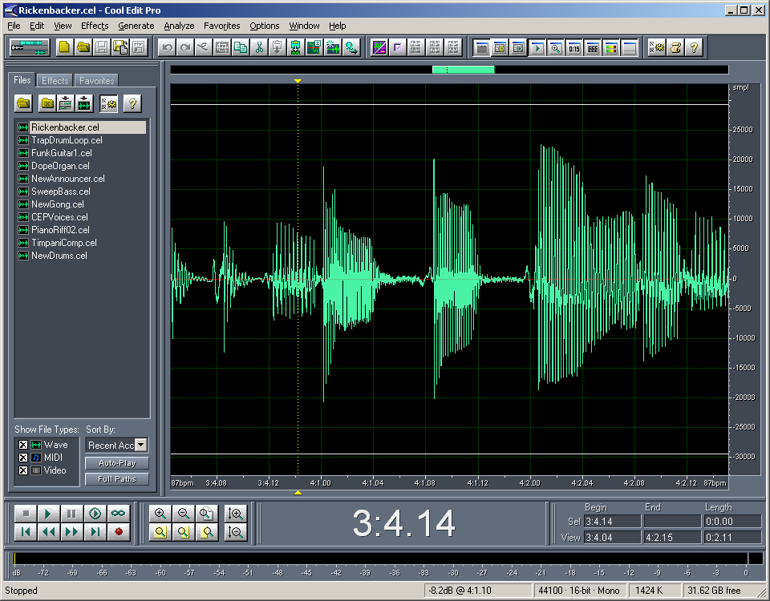
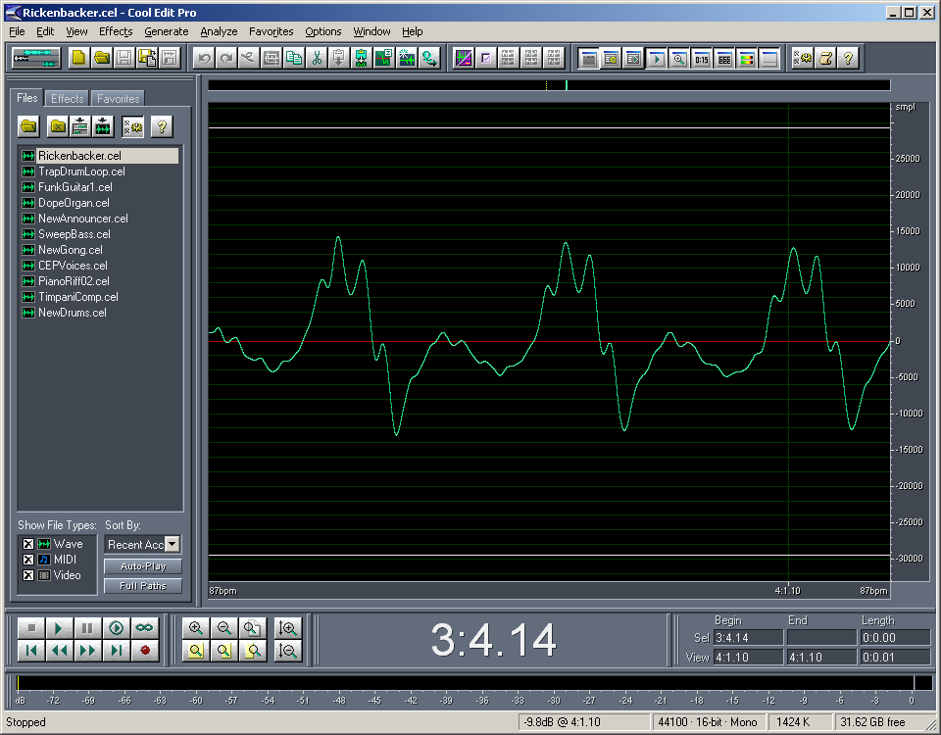
Sampling and Quantization of Audio
An Audio Signal
The rate at which a continuous wave form is sampled is called the sampling rate.

Slide 27
Sampling Audio
Any signal can be represented as the sum of sin waves.
Good sampling follows Nyquist theorem
If we have a signal with frequency components, f₁ < f₂ <…<f_{n}, what is the sampling frequency we can use?
Nyquist theorem: the necessary condition of reconstructing a continuous signal from the sampling version is that the sampling frequency is f_{s} = 2*f_{max} (where f_{max} is the highest frequency components in the signal)
Range of Human Hearing (Music): 20Hz – 20KHz
We lose high frequency response with age; Women generally have better response than men
To reproduce 20 kHz requires a sampling rate of 40 kHz
Speech (like telephony) signal frequency is 5Hz–4KHz
According to Nyquist, it would take 8,000 samples (2 times 4,000) to capture a 4,000 Hz signal perfectly.

Slide 28
Sampling for an Audio Signal
When capturing audio covering the entire 20Hz – 20KHz range of human hearing, such as when recording music, audio wave forms are typically sampled at 44.1 KHz (CD) 48 KHz (professional audio)
Signal Period T, f = 1/T
Sampling period Ts,
fs =1/Ts
Problem: There are infinite number of possible sin waves going through the sampling points

Slide 29
Digital Audio
Music has more high frequency components than speech.
44 KHz is the sampling frequency for music.
8 kHz sampling is good enough for telephone quality speech, since all the energy is contained in the 5Hz – 4 KHz ranges.
Audio is typically recorded at 8-, 16-, and 20- bit depth. CD quality audio is recorded at 16-bit
You often hear an audio (music) which is quantized at 16 bits for each sampled data at 44 kHz.
16 bits means each sample is represented as a 16bit integer, which results in 65, 536 possible values.

Slide 30
Sampling and Quantization of Image
The sampling theorem applies to 2D signal (images) too.
Pixels are small point samples
Sampling on a grid
During sampling we have to determine the sampling rate, like every third pixel sampled. The intermediate pixels are filled in with the sampled values.

Slide 31
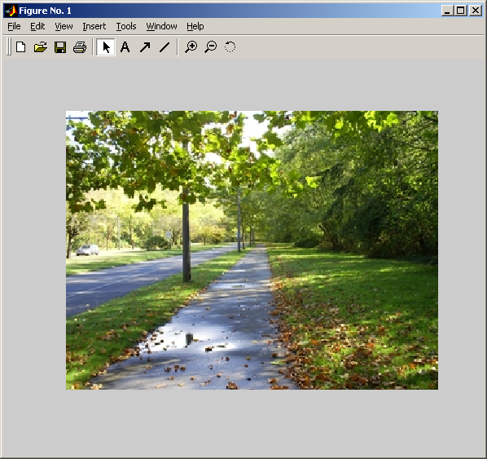
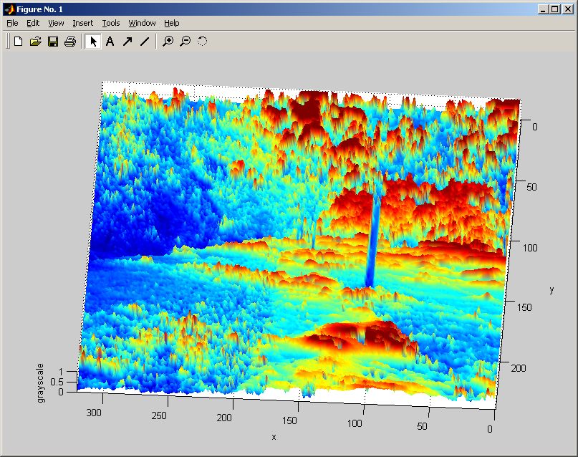
Digital Images
To store an image, the image contains a 2D samples of a surface, which can be represented as matrices.
Each sample in an image is called a pixel – the smallest image resolution elements.
Each pixel has a numerical value, that is, the number of bits available to code a pixel which is dependent on the type of images.

Slide 32
Types of Digital Images
Grayscale image
Usually we use 256 levels for each pixel. That means, the numerical value for gray levels range from 0 (for black pixels) to FF (256) for white. Thus we need 8 bits to represent each pixel (2⁸ = 256)
Gray scale ranges from black to grays and finally to white.
Binary Image
A binary image has only two values (0 or 1). A numerical value may represent either a black (0) or a white (1) dot/pixel.
Binary image is quite important in image analysis and object detection applications.
A 8 bit grayscale
Image.

Slide 33
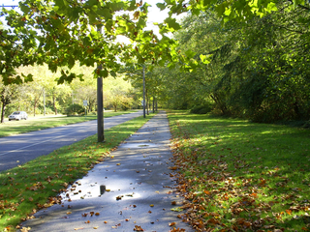
Color Image
Characterization of light is central to the science of color.
There are different color models: RGB, YUV, YIQ, HSV, CMYK, etc.
R
G
B
24 bit image

Slide 34
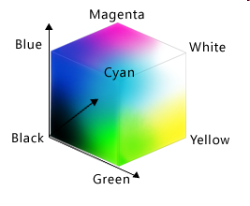
RGB Color Model
To form a color with RGB, three separate color signals of one red, one green, & one blue must be mixed. Each of the three signals can have an arbitrary intensity, from fully off to fully on, in the mixture.
The RGB color model is an additive color mixing model using which every color can be encoded as a combination of red, green, & blue light.
Projection of primary color lights on a screen shows secondary colors where they overlap; for instance, the combination of all three of red, green, & blue in appropriate intensities makes white.
B
R
G
Red

Slide 35
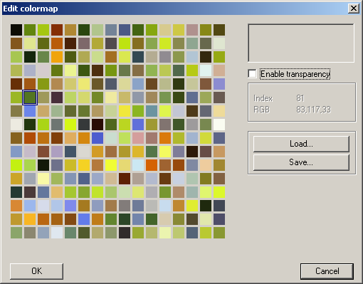

Color Table
Clusters of colors
Image with 256 colors
It is possible to use much less colors to represent a color image without much degradation.

Slide 36

RGB Color Model
The main purpose of the RGB color model is for display of images in electronic systems, such as televisions and computers.
Typical RGB input devices are color TV & video cameras, image scanners, and digital cameras.
Typical RGB output devices are TV sets of various technologies (CRT, LCD, plasma, etc.), computer and mobile video projectors, phone displays, etc.
Color printers, on the other hand, are usually not RGB devices, but subtractive color devices (typically CMYK color model).

Slide 37
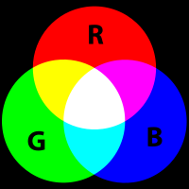
RGB color model
The figure shows an RGB image, along with its separate R, G and B components. Note that,
strong red, green, and blue produces white color; likewise, strong red and green with little blue gives brown; strong green with little red or blue gives dark green; strong blue and moderately strong red and green provides light blue sky.
The number of bits used to represent each pixel in RGB space is called the pixel depth.
Consider an RGB image in which each of the red, green, and blue color is an 8-bit representation. Under these conditions each RGB color pixel have a depth of 24 bits.
Compute the total number of colors in a 24-bit RGB image ?

Slide 38
Representing an Image
To represent an image without noticeable deterioration, we would have to use a matrix of at least 640 x 480 pixels.
How much space is required by the grey-scale image with such specification ?
Where each pixel is represented by an 8-bit integer, this image specification results in a matrix containing 307, 200 byte (eight-bit numbers) or (a total of 2,457,600 bits or 300 KBs).
This is also true for video Graphics Array (VGA) or configuring graphics card of computers.

Slide 39
Image Storing format & compression
The most popular image storing formats include: BMP, JPG, GIF, TIF, PNG, PPM, …
To store an image, it is represented in a 2-D matrix, in which each value corresponds to the data associated with one image pixel.
The image formats also influence storage requirements of image. If storage space is scarce, images should be compressed in a suitable way. If sufficient memory available, the image can be stored uncompressed.
For instance;
BMP (Bit Map) format does not compress the original image.
GIF (Graphics Interchange Format ) type images are compressed to some percentage of their original size with no loss in image quality. It supports up to 256 colors.
JPEG (Joint Photographic Experts Group) became an ISO international standard for compression of images. It applies to color and gray-scaled images.

Slide 40
Video Sampling and Quantization
Analog video signal is continuous in space and time and sampling considers both time and space.
Video sampling break the frame into 720 x 480 pixels (for US NTSC) or 704 x 576 pixels (for UK PAL )
Frame N-1
Video quantization is essentially the same as image quantization
During video quantization each pixel is represented by a bit depth of, say 8-bits representing luminance and color information.
time
Frame 0

Slide 41
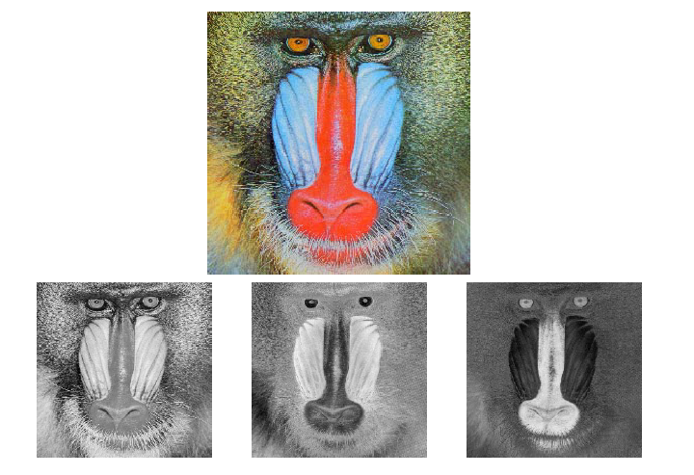
Color System in Video
Video signals are often transmitted to the receiver over a single television channel
In order to encode color, a video signal is decomposed into three sub-signals: a luminance signal and two color signals.
Since human vision is more sensitive to brightness than to color, a more suitable color encoding system separates the luminance from color information. Such models include YUV, YIQ, etc.
The YUV color model: While RGB model separates colors, YUV model separates brightness (luminance) information from the color information. Y is the luminance component (brightness) and U and V are color components
It is obtained from RGB using the following equations.
Y = 0.299 R + 0.587 G + 0.144 B
U = B – Y
V = R - Y
Y U V

Slide 42
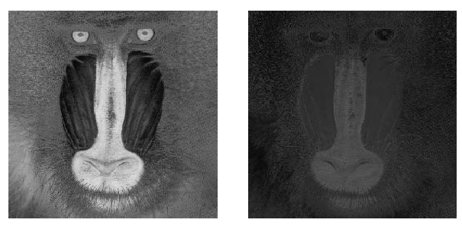
Color System in Video
YIQ color model
YIQ color model is a similar encoding system like YUV.
It produces the I and Q colors and adds the modulated signal to the luminance Y.
It is obtained from RGB using the following equations.
Y = 0.3 R + 0.59 G + 0.11 B
I = 0.60 R – 0.28 G – 0.32 B
Q = 0.21 R – 0.52 G + 0.31 B
I Q

Slide 43
Video Storing format & compression
Each video formats support various resolutions and color presentation. The following are the well-known video formats
The Color Graphics Adaptor (CGA):
Has a resolution of 320 x 200 pixels with simultaneous display of four colors
What is the necessary storage capacity per frame?
The Enhanced Graphics Adaptor (EGA):
Supports display resolution of 640 x 350 pixels with 16 simultaneous display colors
What is the necessary storage capacity per frame?
The Video Graphics Array (VGA):
Works mostly with a resolution of 640 x 480 pixels with 256 simultaneous display colors
What the necessary storage capacity per frame ?
The Supper Video Graphics Array (SVGA):
Can present 256 colors at a resolution of 1024 x 768 pixels.
What is the necessary storage capacity per frame?
Other SVGA modes include 1280 x 1024 pixels and 1600 x 1280 pixels.

Slide 44
Exercise
Suppose we have 24 bits per pixel available for a color image. We also note that humans are more sensitive to red and green colors than to blue, by a factor of approximately 1.5 times. How may we design a simple color representation to make use of the bits available?
Quite a simple scheme:
Since Blue is less perceptually important use less bits to represent blue color. Use proportionately more bits for red and green rather than blue
Therefore Red and Green use 9 bits each and Blue 6 bits to represent pixel values
Need to quantize at different levels for blue and Red/green

Slide 45
Multimedia Data Compression

Slide 46
Multimedia Data Compression
Data compression is about finding ways to represent the content in fewer bits or bytes
It is the process of encoding information using fewer bits
For example, the ZIP file format, which provides compression, also acts as an archiver, storing many source files in a single destination output file.
As with any communication, compressed data communication only works when both the sender and receiver of the information understand the encoding scheme.
Thus, compressed data can only be understood if the decoding method is known by the receiver.

Slide 47
Is compression useful?
Compression is useful because it helps reduce the consumption of resources, such as hard disk space or transmission bandwidth.
save storage space requirement: handy for storing files as they take up less room.
speed up document transmission time: convenient for transferring files across the Internet, as smaller files transfer faster.
On the downside, compressed data must be decompressed to be used, and this extra processing may be harmful to some applications.
For instance, a compression scheme for video may require expensive hardware for the video to be decompressed fast enough to be viewed as it's being decompressed
The option of decompressing the video in full before watching it may be inconvenient, and requires storage space for the decompressed video.

Slide 48
Trade offs in Data Compression
The design of data compression schemes therefore involves trade-offs among various factors, including
the degree of compression
To what extent the data should be compressed?
the amount of distortion introduced
To what extent quality loss is tolerated?
the computational resources required to compress and decompress the data.
Do we have enough memory and processing power required for compressing and decompressing the data?

Slide 49
Types of Compression
Lossless Compression
Lossy Compression
M
M
Lossless Compress
Compress with loss
m
m
M’ ≈ M
Uncompress
Uncompress
M
M’
M = Message/data Transmitted
Notes:
Before we look at Information theory lets make a clear distinction between lossless compression and compression with loss, or sometimes referred to as lossy compression.
Notice from the two figures:
When lossless compression is used the compressed media, M, does not loose any content, therefore, uncompressing it restores the media to its native state, M.
On the other hand with a lossy compression, the compressed media when uncompressed is different from the original media. Depending on the mechanism used the difference might be too subtle to notice.

Slide 50

Data Compression
Raw image takes about 6M bytes
(without header information)
24k bytes with jpeg, Q=50

Slide 51
Lossy and Lossless Compression
Lossless compression does not lose any data in the process.
Lossless compression is possible because most real-world data has statistical redundancy. It packs data into a smaller file size by using a kind of internal shorthand to signify redundant data. If an original file is 1.5MB, this technique can reduce up to half of the original size.
For example, in English text, the letter 'e' is more common than the letter 'z', and the probability that the letter 'q' to be followed by the letter 'z' is very small.
GIF image files and WinZip use lossless compression. For this reason zip software is popular for compressing program and data files.
Lossless compression has advantages and disadvantages.
The advantage is that the compressed file will decompress to an exact duplicate of the original file, mirroring its quality.
The disadvantage is that the compression ratio is not all that high, precisely because no data is lost.
To get a higher compression ratio -- to reduce a file significantly beyond 50% -- you must use lossy compression.

Slide 52
Lossy and Lossless Compression
Lossy compression will strip a file of some of its redundant data. Because of this data loss, only certain applications are fit for lossy compression, like graphics, audio, and video.
Lossy compression necessarily reduces the quality of the file to arrive at the resulting highly compressed size.
Lossy data compression will be guided by research on how people perceive the data in question.
For example, the human eye is more sensitive to subtle variations in luminance (i.e. brightness) than it is to variations in color.
JPEG image compression works in part by "rounding off" some of this less-important information.

Slide 53
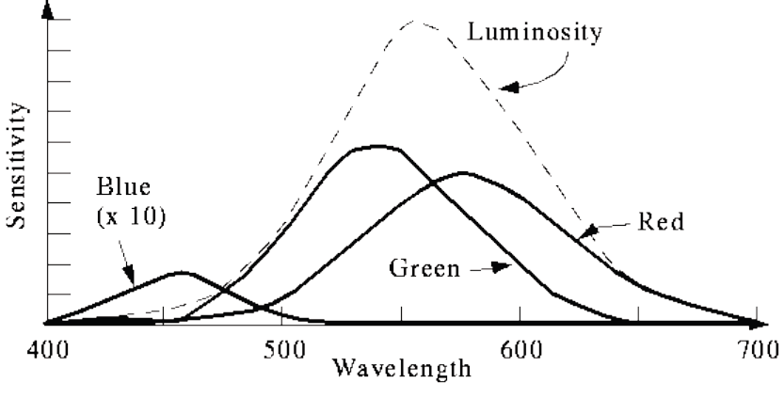
Human visual system
What characteristics of the human visual system can be exploited in related to compression of color images and video?
The eye is basically sensitive to color intensity
Each neuron is either a rod or a cone. Rods are not sensitive to color.
Cones come in 3 types: red, green and blue.
Each responds differently --- Non linearly and not equally for RGB differently to various frequencies of light.

Slide 54
Lossless vs. Lossy compression
Lossless & lossy compression have become part of our every day vocabulary due to the popularity of MP3 music file, JPEG image file, MPEG video file, winzip, etc
A sound file in WAV format, converted to a MP3 file will lose much data as MP3 employs a lossy compression; resulting in a file much smaller so that several dozen MP3 files can fit on a single storage device, vs. a handful of WAV files. However the sound quality of the MP3 file will be slightly lower than the original WAV.
JPEG uses lossy compression, while GIF follows lossless compression techniques
Hence GIF compresses only up to 25%; as a result of which converting a GIF file to JPEG format will reduce it in size. It will also reduce the quality to some extent.
It is our personal choice to compress video, graphics or audio,
Good results depend heavily on the quality of the original file.

Slide 55
Example: Lossless vs. lossy compression
An example of lossless vs. lossy compression is the following string:
25.888888888
This string can be compressed as: 25.9!8
Interpreted as, "twenty five point 9 eights", the original string is perfectly recreated, just written in a smaller form.
In a lossy system it can be compressed as: 26
In which case, the original data is lost, at the benefit of a smaller file size
The two simplest compression techniques are: Zero length suppression & run length encoding.

Slide 56
Run length encoding compression techniques
Data often contains sequences of identical bytes. By replacing these repeated byte sequences with the number of occurrences, a substantial reduction of data can be achieved.
In Run-length encoding, large runs of consecutive identical data values are replaced by a simple code with the data value and length of the run, i.e.
(dataValue, LengthOfTheRun)
This encoding scheme tries to tally occurrence of data value (X_{i}) along with its run length, i.e.(X_{i} , Length_of_X_{i})

Slide 57
Run-length Encoding (RLE)
It compress data by storing runs of data (that is, sequences in which the same data value occurs in many consecutive data elements) as a single data value & count.
This method is useful on data that contains many such runs. Otherwise, It is not recommended for use with files that don't have many runs as it could potentially double the file size.
For example, consider the following image with long runs of white pixels (W) and short runs of black pixels (B). WWWWWWWWWWBWWWWWWWWWBBBWWWWWWWWWWWW
If we apply the run-length encoding (RLE) data compression algorithm, the compressed code is :
10W1B9W3B12W (Interpreted as ten W's, one B, nine W's, three B's,twelveWs)
It is used in fax machines (combined with Modified Huffman coding). It is relatively efficient because faxed documents are mostly white space, with occasional interruptions of black.

Slide 58
Zero length suppression compression techniques
Zero length suppression: if in a sequence a series on n successive tokens appears we can replace these with a token and a count of number of occurrences. we usually need to have a special code to denote when the repeated token appears
Example: given the number
894000000 … 0 (where there are 32 zeros)
zero length replace it with
894f32
where f is the code of zero

Slide 59
Application: Lossless vs. lossy compression
For symbolic data such as spreadsheets, text, executable programs, etc., losslessness is essential because changing even a single bit cannot be tolerated.
For visual and audio data, some loss of quality can be tolerated without losing the essential nature of the data.
By taking advantage of the limitations of the human sensory system, a great deal of space can be saved while producing an output which is nearly indistinguishable from the original.
In audio compression, for instance, non-audible (or less audible) components of the signal are removed.
Lossy compression is used for:
image compression in digital cameras,
audio compression for Internet telephony and CD ripping, which is decoded by audio players.
video compression in DVDs with MPEG format.

Slide 60
Lossless vs. Lossy compression
Generally, the difference between the two compression technique is that:
Lossless compression schemes are reversible so that the original data can be reconstructed,
Lossy compression schemes accept some loss of data in order to achieve higher compression.
These lossy data compression methods typically offer a three-way tradeoff between
Computer resource requirement (compression speed, memory consumption)
compressed data size and
quality loss.

Slide 61
Common compression methods
Statistical methods:
It requires prior information about the occurrence of symbols
E.g. Huffman coding and Entropy coding
Estimate probabilities of symbols, code one symbol at a time, shorter codes for symbols with high probabilities
Dictionary-based coding
The previous algorithms (both entropy and Huffman) require the statistical knowledge which is often not available (e.g., live audio, video).
Dictionary based coding, such as Lempel-Ziv (LZ) compression techniques do not require prior information to compress strings.
Rather, replace symbols with a pointer to dictionary entries

Slide 62
Common Compression Techniques
Compression techniques are classified into static, adaptive (or dynamic), and hybrid.
Static coding requires two passes: one pass to compute probabilities (or frequencies) and determine the mapping, & a second pass to encode.
Examples: Huffman Coding, entropy encoding
Adaptive coding:
It adapts to localized changes in the characteristics of the data, and don't require a first pass over the data to calculate a probability model. All of the adaptive methods are one-pass methods; only one scan of the message is required.
The cost paid for these advantages is that the encoder & decoder must be complex to keep their states synchronized, & more computational power is needed to keep adapting the encoder/decoder state.
Examples: Lempel-Ziv and Adaptive Huffman Coding

Slide 63
Adaptive coding
Static method
Encoder
Initialize the data model based on a first pass over the data.
Transmit the data model.
While there is more data to send
Encode the next symbol using the data model and send it.
Decoder
Receive the data model.
While there is more data to receive
Decode the next symbol using the data model and output it.
Adaptive method
Encoder
Initialize the data model as per agreement.
While there is more data to send
Encode the next symbol using the data model and send it.
Modify the data model based on the last symbol.
Decoder
Initialize the data model as per agreement.
While there is more data to receive
Decode the next symbol using the data model and output it.
Modify the data model based on the decoded symbol.
The key in adaptive model is that, both encoder and decoder use exactly the same initialize model and encode/decode model.

Slide 64
Compression model
Almost all data compression methods involve the use of a model, a prediction of the composition of the data.
When the data matches the prediction made by the model, the encoder can usually transmit the content of the data at a lower information cost, by making reference to the model.
In most methods the model is separate, and because both the encoder and the decoder need to use the model, it must be transmitted with the data.
In adaptive coding, the encoder and decoder are instead equipped with identical rules about how they will alter their models in response to the actual content of the data
both start with a blank slate, meaning that no initial model needs to be transmitted.
As the data is transmitted, both encoder and decoder adapt their models, so that unless the character of the data changes radically, the model becomes better-adapted to the data it's handling and compresses it more efficiently.

Slide 65
Data Compression = Modeling + Coding
Data Compression consists of taking a stream of symbols and transforming them into codes.
The model is a collection of data and rules used to process input symbols and determine their probabilities.
A coder uses a model (probabilities) to assign codes for the given input symbols
We will take Huffman coding to demonstrate the distinction:
Input
Stream
Symbols
Output
Stream
Model
Probabilities
Encoder
Codes
Notes:
Information theory has motivated the idea that a Data source has an entropy that gives us the inherent information content it possess.
If we can find codes to assign to symbols that will result in the data source being encoded in the fewest number of bits as indicated by their entropy then we can achieve maximum compression.
That is, if the encoding of the data source reflects its entropy then we would have reached the optimal (minimal) coding for the source.
There are two components to compression: Modeling and Coding.
The model involves reasoning that does into capturing the

Slide 66
Huffman coding
0
1
Developed in 1950s by David Huffman, widely used for text compression, multimedia codec and message transmission
The problem: Given a set of n symbols and their weights (or frequencies), construct a tree structure (a binary tree for binary code) with the objective of reducing memory space and decoding time per symbol.
For instance, Huffman coding is constructed based on frequency of occurrence of letters in text documents
D₄
0
1
1
D₃
0
D₁
D₂
Code of:
D₁ = 000 D₂ = 001 D₃ = 01 D₄ = 1
Notes:
Information theory has motivated the idea that a Data source has an entropy that gives us the inherent information content it possess.
If we can find codes to assign to symbols that will result in the data source being encoded in the fewest number of bits as indicated by their entropy then we can achieve maximum compression.
That is, if the encoding of the data source reflects its entropy then we would have reached the optimal (minimal) coding for the source.
There are two components to compression: Modeling and Coding.
The model involves reasoning that does into capturing the

Slide 67
Huffman coding
The Model could determine raw probabilities of each symbol occurring anywhere in the input stream.
p_{i} = # of occurrences of S_{i}
Total # of Symbols
The output of the Huffman encoder is determined by the Model (probabilities).
The higher the probability of occurrence of the symbol, the shorter the code assigned to that symbol and vice versa.
This will enable to easily control the most frequently occurring symbols in a data and also reduce the time taken during decoding each symbols.

Slide 68
How to construct Huffman coding
Step 1: Create forest of trees for each symbol, t₁, t₂,… t_{n}
Step 2: Sort forest of trees according to falling probabilities of symbol occurrence
Step 3: WHILE more than one tree exist DO
Merge two trees t₁ and t₂ with least probabilities p₁ and p₂
Label their root with sum p₁ + p₂
Associate binary code: 1 with the right branch and 0 with the left branch
Step 4: Create a unique codeword for each symbol by traversing the tree from the root to the leaf.
Concatenate all encountered 0s and 1s together during traversal
The resulting tree has a prob. of 1 in its root and symbols in its leaf node.

Slide 69
Example
Consider a 7-symbol alphabet given in the following table to construct the Huffman coding.
Symbol | Probability
a | 0.05
b | 0.05
c | 0.1
d | 0.2
e | 0.3
f | 0.2
g | 0.1
The Huffman encoding algorithm picks each time two symbols (with the smallest frequency) to combine

Slide 70
Huffman code tree
1
0
1
0.4
0.6
0
0
1
1
0.3
e
d
f
1
0
0.2
1
g
0
0.1
0
1
c
a
b
Using the Huffman coding a table can be constructed by working down the tree, left to right. This gives the binary equivalents for each symbol in terms of 1s and 0s.
What is the Huffman binary representation for ‘café’?

Slide 71
Algorithm
procedure HuffmanCode(H,n)
// H is the Huffman tree
for i = 1 to n-1 do
r = new Nodetype
r→lchild = least(H)
r→rchild = least(H)
r→frequency = r→lchild→frequency + r→rchild→frequency
insert(H,r)
end for
return (H)
end procedure

Slide 72
Word level example
Given text: “for each rose, a rose is a rose”
Construct the Huffman coding

Slide 73
Entropy encoding
According to Shannon, the entropy of an information source S is defined as:
H(S) = Σ_{i} (p_{i} log ₂ (1/p_{i} ))
log ₂ (1/p_{i} ) indicates the amount of information contained in symbol S_{i}, i.e., the number of bits needed to code symbol S_{i}.
Example. What is the entropy of a gray-scale image with uniform distribution of gray-level intensity?
The entropy of the image, H(S)= Σ_{i} (1/256 log ₂ (1/1/256))= 8 bits, which indicates that 8 bits are needed to code each gray level
Question 1: What is the entropy of a source with M symbols where each symbol is equally likely?
Entropy, H(S) = log₂ M
Question 2: How about an image in which half of the pixels are white and half are black?
Entropy, H(S) = 1
Notes:
Information theory deals with the questions of “information content” of a data source, also referred to as the entropy of the source.
The entropy H of a source S is given by the formula H(S)…, where,
P sub I is the probability of occurrence of symbol S sub I
The formula simply states that the information content of a source is given by the sum of the logarithms of the information content of each symbol weighed by its probability.
The information content of a given symbol S sub I is given by log 1 over P sub I to the base 2. The units are bits.
The term (log 1 over P_I) is sometimes referred to as the uncertainty of the symbol S_I.
The greater the probability of occurrence of a symbol, the lower its uncertainty and hence fewer bits are needed to represent it.
Similarly lower the probability of occurrence of a symbol higher its uncertainty and hence more bits are needed to represent it.
Observe that the entropy of a source is highest when all symbols are equally likely.
Work the two questions out while you are on this slide, they are simple applications of the Entropy formula.

Slide 74
Entropy Encoding
Entropy is a measure of how much information is encoded in a message. Higher the entropy, higher the information content.
We could also say entropy is a measure of uncertainty in a message. Information and Uncertainty are equivalent concepts.
The units (in coding theory) of entropy are bits per symbol. It is determined by the base of the logarithm:
2: binary (bit);
10: decimal (digit).
Entropy gives the actual number of bits of information contained in a message source.
Example: If the probability of the character ‘e’ appearing in this slide is 1/16, compute the information content of this character?
H(S) = 4 bits.
So, the character string “eeeee” has a total content of 20 bits (in contrast the use of an 8-bit ASCII coding result in 40 bits to represent “eeeee”).
Notes:
Lets try to get some more insight into the purport of the Entropy equation
Entropy is a measure of information content or uncertainty.
Example:
4 bits because the information content of the letter e is log (1/1/16) which is log 16, which is 4.
Refer to the Information theory primer for a quick brush up on logarithms and their properties.

Slide 75
The Shannon-Fano Encoding Algorithm
Calculate the frequencies of each of the symbols in the list.
Sort the list in (decreasing) order of frequencies.
Divide the list into two half’s, with the total frequency counts of each half being as close as possible to the other.
The right half is assigned a code of 0 and the left half with a code of 1.
Recursively apply steps 3 and 4 to each of the halves, until each symbol has become a corresponding code leaf on a tree.
Notes:
Screen1: Say, we are given that there are five symbols (A thru E) that can occur in a source with their frequencies being 15 7 6 6 and 5. First sort the symbols in decreasing order of frequency.
Screen2: Divide the list into two equal halves. That is, the counts of both halves are as close as possible to each other. So in this case we split the list between B and C. The upper half of the list is assigned a code 0 and the lower part is assigned a 1.
Screen3: We recursively repeat the steps of splitting and assigning code till each symbol become a code leaf on the tree. That is, treat each split as a list and apply splitting and code assigning till you are left with lists of single elements.
Screen 4: Note that we split the list containing C, D and E between C and D because the difference between the split lists is 11 minus 6 which is 5, if we were to have divided between D and E we would get a difference of 12-5 which is 7.
Screen 5: We complete the algorithm and as a result have codes assigned to the symbols.
Screen 6, 7, 8: Lets do a little analysis. The table shows the entropy of each symbol along with the codes assigned by the Shannon-Fano Coding. We also compute the contribution in bits of each symbol.. We note that it takes a total of 89 bits using the Shannon-Fano Algorithm to encode 85.25 bits of information. I encourage you to compute what it would take if we used ASCII.

Slide 76
The Shannon-Fano Encoding Algorithm
Example: Given symbols A to E and their corresponding frequency counts encode them using Shannon-Fano entropy encoding
Symbol
A
B
C
D
E
Count
15
7
6
6
5
0
0
1
1
1
0
1
0
1
1
0
1
Symbol | Count | Info. -log₂(p_{i}) | Code | Number of Bits
A | 15 | 1.38 | 00 | 30
B | 7 | 2.48 | 01 | 14
C | 6 | 2.70 | 10 | 12
D | 6 | 2.70 | 110 | 18
E | 5 | 2.96 | 111 | 15
x
x
x
x
It takes a total of 89 bits to encode 85.25 bits of information.
x
85.25
89
Notes:
Screen1: Say, we are given that there are five symbols (A thru E) that can occur in a source with their frequencies being 15 7 6 6 and 5. First sort the symbols in decreasing order of frequency.
Screen2: Divide the list into two equal halves. That is, the counts of both halves are as close as possible to each other. So in this case we split the list between B and C. The upper half of the list is assigned a code 0 and the lower part is assigned a 1.
Screen3: We recursively repeat the steps of splitting and assigning code till each symbol become a code leaf on the tree. That is, treat each split as a list and apply splitting and code assigning till you are left with lists of single elements.
Screen 4: Note that we split the list containing C, D and E between C and D because the difference between the split lists is 11 minus 6 which is 5, if we were to have divided between D and E we would get a difference of 12-5 which is 7.
Screen 5: We complete the algorithm and as a result have codes assigned to the symbols.
Screen 6, 7, 8: Lets do a little analysis. The table shows the entropy of each symbol along with the codes assigned by the Shannon-Fano Coding. We also compute the contribution in bits of each symbol.. We note that it takes a total of 89 bits using the Shannon-Fano Algorithm to encode 85.25 bits of information. I encourage you to compute what it would take if we used ASCII.

Slide 77
Exercise
Given the following symbols and their corresponding frequency of occurrence, find an optimal binary code for compression:
Using the Huffman algorithm
Using Entropy coding scheme
Character: | a | b | c | d | e | t
Frequency: | 16 | 5 | 12 | 17 | 10 | 25
Notes:
8

Slide 78
Lempel-Ziv Encoding
Data compression up until the late 1970's mainly directed towards creating better methodologies for Huffman coding.
An innovative, radically different method was introduced in1977 by Abraham Lempel and Jacob Ziv.
This technique (called Lempel-Ziv) actually consists of two considerably different algorithms, LZ77 and LZ78.
Due to patents, LZ77 and LZ78 led to many variants:
The zip and unzip use the LZH technique while UNIX's compress methods belong to the LZW and LZC classes.
 |  | LZH | LZB | LZSS | LZR | LZ77 Variants
LZFG | LZJ | LZMW | LZT | LZC | LZW | LZ78 Variants

Slide 79
Lempel-Ziv compression
The problem with Huffman coding is that it requires knowledge about the data before encoding takes place.
Huffman coding requires frequencies of symbol occurrence before code-word is assigned to symbols
Lempel-Ziv compression:
Not rely on previous knowledge about the data
Rather builds this knowledge in the course of data transmission/data storage
Lempel-Ziv algorithm (called LZ) uses a table of code-words created during data transmission;
each time it replaces strings of characters with a reference to a previous occurrence of the string.

Slide 80
Lempel-Ziv Compression Algorithm
The multi-symbol patterns are of the form: C₀C₁ . . . C_{n-1}C_{n}. The prefix of a pattern consists of all the pattern symbols except the last: C₀C₁ . . . C_{n-1}
Lempel-Ziv Output: there are three options in assigning a code to each symbol in the list
If one-symbol pattern is not in dictionary, assign (0, symbol)
If multi-symbol pattern is not in dictionary, assign (dictionaryPrefixIndex, lastPatternSymbol)
If the last input symbol or the last pattern is in the dictionary, assign (dictionaryPrefixIndex, )

Slide 81
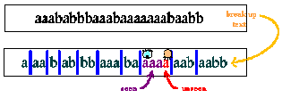
Example: LZ compression
Example: Given a word, aaababbbaaabaaaaaaabaabb containing only two letters, a and b, compress it using LZ technique.
Steps in Compression
First, split the given word into pieces of symbols
In the example, the first piece of our sample text is a. The second piece must then be aa. If we go on like this, we obtain the breakdown of data as illustrated below:
Note that, the shortest piece of data is the string of characters that we have not seen so far.
seen
unseen

Slide 82
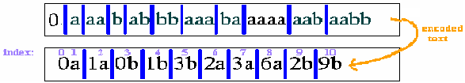
LZ Compression
Second, index the pieces of text obtained in the breaking-down process from 1 to n.
The empty string (start of text) has index 0, a has index 1, ...
Third, number the pieces of data using the above indices.
Thus a, with the initial string, is numbered Oa. String 2, aa, is numbered 1a, because it contains a, whose index is 1, and the new character a. Proceed numbering all the pieces in terms of those preceding them.
Is replacing characters by integers compress the given text ?

Slide 83
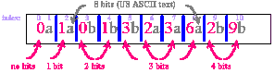
LZ Compression
Now, compute how many bits needed to represent this coded information.
each piece of text is composed of an integer and an alphabet.
The number of bits needed to represent each integer with index i is at most equal to the number of bits used to represent the (i -1)^{th} index. For example,
the number of bits needed to represent 6 in piece 8 is equal to 3, because it takes three bits to express 7 (the (n-1)th index) in binary.
One of the advantages of Lempel-Ziv compression is that in a long string of text, the number of bits needed to transmit the coded information is peanuts compared to the actual length of the text.
E.g. To transmit the actual text aab, 24 bits (8 + 8 + 8) needed, where as for the code 2b, 12 bits needed.

Slide 84
LZ Compression Algorithm
Dictionary ← empty ; Prefix ← empty ; DictionaryIndex ← 1;
while(symbolStream is not empty)
Symbol ← next symbol in symbolStream;
if(Prefix + Symbol exists in the Dictionary)
Prefix ← Prefix + Symbol ;
else
if(Prefix is empty)
CodeWordForPrefix ← 0 ;
else
CodeWordForPrefix ← DictionaryIndex for Prefix ;
Output: “CodeWordForPrefix, Symbol” ;
insertInDictionary( ( DictionaryIndex , Prefix + Symbol) );
DictionaryIndex++ ;
Prefix ← empty ;
end else
end while
if(Prefix is not empty)
CodeWordForPrefix ← DictionaryIndex for Prefix;
Output: “CodeWordForPrefix , “;
end if

Slide 85
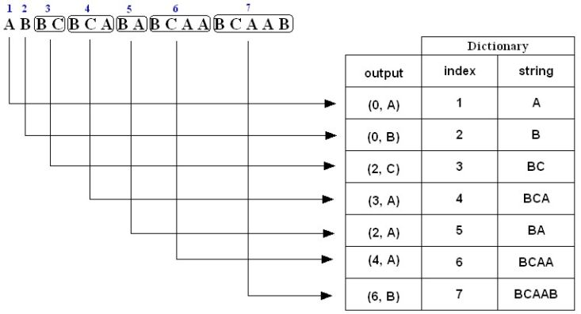
Example 2: LZ Compression
Encode (i.e., compress) the string ABBCBCABABCAABCAAB using the LZ algorithm.
The compressed message is: (0,A)(0,B)(2,C)(3,A)(2,A)(4,A)(6,B)
Note: The above is just a representation, the commas and parentheses are not transmitted;

Slide 86
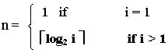
Example 2: Compute Number of bits transmitted
Consider the string ABBCBCABABCAABCAAB given in example 2 (previous slide) and compute the number of bits transmitted:
Number of bits = Total No. of characters * 8 = 18 * 8 = 144 bits
The compressed string consists of codewords and the corresponding codeword index as shown below:
Codeword: (0, A) (0, B) (2, C) (3, A) (2, A) (4, A) (6, B)
Codeword index: 1 2 3 4 5 6 7
Each code word consists of a character and an integer:
The character is represented by 8 bits
The number of bits n required to represent the integer part of the codeword with index i is given by:
Codeword (0, A) (0, B) (2, C) (3, A) (2, A) (4, A) (6, B)
Index 1 2 3 4 5 6 7
Bits: 1 + 8) + (1 + 8) + (2 + 8) + (2 + 8) + (3 + 8) + (3 + 8) + (3 + 8) = 71 bits
The actual compressed message is: 0A0B10C11A010A100A110B
where each character is replaced by its binary 8-bit ASCII code.

Slide 87
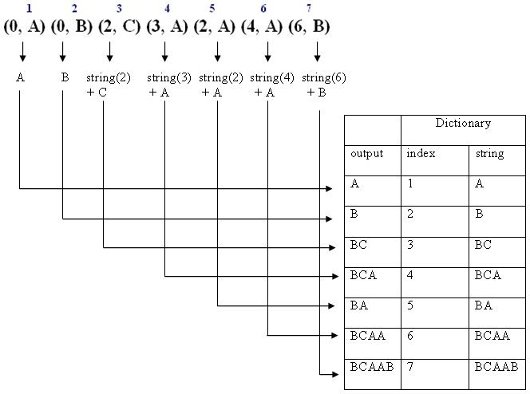
Example 3: Decompression
Decode (i.e., decompress) the sequence (0, A) (0, B) (2, C) (3, A) (2, A) (4, A) (6, B)
The decompressed message is: ABBCBCABABCAABCAAB

Slide 88
Exercise
Encode (i.e., compress) the following strings using the Lempel-Ziv algorithm.
1. ABBCBCABABCAABCAAB
2. SATATASACITASA.

Slide 89
Optical Storage Media
MID Semester exam will be on Friday Dec 9, 2016 at 1:00 PM
(covers until Data compression)

Slide 90
Choice of storage
Multimedia data needs more storage than others
Choice of storage media depends on user’s circumstances
Quantity and type of information at stock,
Required access time & transfer rate
Stability of data
Number of users & their skills
Optical Storage media continues to be extremely popular in computer systems, particularly for Multimedia applications

Slide 91
Optical Storage
Optical storage deals with data storage and is usually considered as a type of tertiary storage.
Tertiary storage comes in the form of low-cost removable media, such as CD-ROMs and floppy disks, while secondary storage comes in the form of the hard disks found within your computer.
Optical storage differs from other types of storage media, such as floppy disks, hard disks, magnetic tapes and flash memory:
Optical storage vary in material composition, technology, and storage capacity, and are mostly cheaper (cost per data bit -wise).
Optical media have higher recording densities. Though hard disks can store larger amounts of data, one must consider the bulkiness of a hard disk compared to the slimness of optical media

Slide 92
Advantages of Optical Storage
Storage Capacity
It has huge capacity; a 4.7-inch CD can hold over 700 Megabytes of data.
Compatibility
Readability of all varieties of CD by any of the huge number of available CD drives
Durability
A laser is used to store and retrieve data on an optical disc, and nothing comes into contact with the recording surface
Optical discs can be accessed thousands of times and will last for decades without deterioration
Scalability
Optical storage technology provides a variety of storage capacities with room to grow from megabytes to terabytes

Slide 93
Advantages of Optical Storage
Accessibility
Unused data can be stored in an easily accessible optical library.
This enables fast storage and retrieval of backup and archive data.
About 100 times faster than magnetic tape
Portability
CDs are robust and durable
They are removable and portable
They can be transported securely
Affordability
The cost of CDs is cheaper; it costs not more than three BIRR
How much CD-R and CD-RW costs? What about DVD?

Slide 94
Advantages over Magnetic disk
Higher data density
Store more data bit per inch
Long-term storage
Insensitive to dust
Low probability of head crashes
Distance between head & the disk is more than 1mm
Adequate error correction
Allows error handling
Quality
Holds high quality multimedia

Slide 95
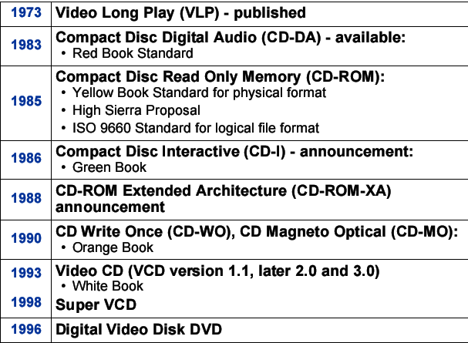
History of optical storage

Slide 96
Types of Optical Storage
Optical storage media can be classified according to their reading technology:
the read-only CD, CD-ROM, DVD-ROM, and DVD-Video;
the write-once CD-R and DVD-R, both of which use WORM (Write-Once, Read-Many-times) technology
the rewritable CD-RW, DVD-RAM, and DVD-RW.
Thus, R in CD-R & DVD-R means "Recordable", RW means "Rewritable", ROM means "Read Only Memory", RAM means "Random Access Memory".
Most optical storage media are optical disks, such as CDs.
The data on optical disks are usually accessed by a laser beam touching the disc's surface.
A 'sub-type' of optical disks is the phase-change disk, which uses a material that can freeze into either a crystalline or amorphous state. Phase-change disks allow rewritable optical media, such as CD-RWs and DVD-RWs.
On the other hand, magneto-optic disks straddle the line, as they're made of magnetic recordable material but use optical technology (i.e. laser) to record the data.

Slide 97
Basic CD technology
Basics
The most common form of optical storage is the Compact Disk (CD).
Even with the arrival of DVDs and other more powerful optical media, CDs remain a massively popular way for industries to package software, games, music, and movies.
Ordinary computer users often have a soft spot for CDs and the CD burner hardware of their PCs, as these discs provide low-cost and easy-to-use back-up for and physical transfer of data files.
The CD is a thin wafer of polycarbonite plastic with a thin metal layer
120mm diameter (4.7 inches)

Slide 98
Basic CD technology
Data storage:
For data storage, the CD is divided into logical sectors (max. 99). Normally there are 75 sectors, and each sector can hold 2 Kbytes
Capacity for a 74 minute CD is
74 X 60 secs X 75 sectors X 2 Kbytes
= 660,000 Kbytes = 650 Megabytes
Because the CD is originally based on audio technology the track is divided as: minutes:seconds:sectors
Tracks contains sequential arrangement of pits & lands. The "holes" on the CD are called pits, while the flat places (i.e. unburned areas) around these holes are called lands.
A continuous spiral of data is recorded starting at the inner edgeto the outside.
How does a CD record data?
Data is recorded on the disc using a laser beam which burns pits (a series of holes) in the disc surface. a change between pit and land (or vice versa) corresponds to a ”1” and no change corresponds to a ”0”

Slide 99
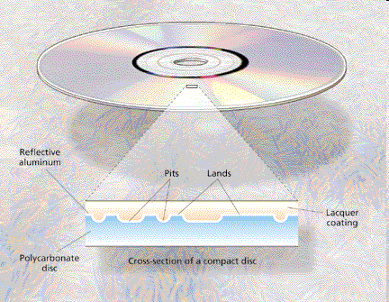
How does a CD record data

Slide 100
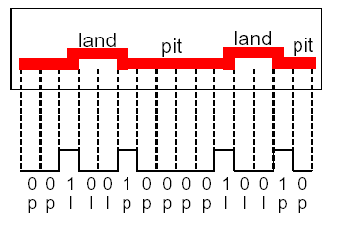
How does a CD record data
Channel bits are stored as pits and lands on a CD where
a change between pit and land (or vice versa) corresponds to a ”1”
no change corresponds to a ”0”
Example:

Slide 101
Optical Storage Types: Audio CD and CD-ROM
Audio CD
The compact disc (CD) which is developed by Philips & Sony Corporation in the 1980s, were audio CDs for storing audio data.
It had a capacity of
74Min play back
650 MB
In 1984, CD-ROMs went beyond audio,
It added software, computer games, encyclopedias, movies, and more.
It also boasted memory capacity to 747 MB & low manufacturing cost.

Slide 102
Optical Storage Types: CD-ROM
CD-ROMs mainly differ from audio CDs in terms of error-correcting code.
While it might be tolerable for an audio CD to have errors (e.g. from time to time, the music skips while playing), it is definitely not tolerable for computer programs, as even the smallest software defect can render the whole program unusable. This means that CD-ROMs have to contain a larger amount of error-correcting code needed to safely store data.
Philips added graphics to the CD-ROM, as well as the ability to interleave audio, video, and data. This made the CD into a true "multimedia" medium.
With the introduction of standardized CD-ROM file system called High Sierra, any standards-conformant CD-ROM readable in any computer running Windows/MS-DOS, Unix, etc.
CD-ROM Drive Speeds
It's good to remember that while CD-ROMs are economical, CD drives aren't up to par with your computer's hard disk.
Hard disks are at an entirely higher performance category, as these can transfer and access data much faster than CD drives.
Speed of most CD-ROM drives today hover around 50x

Slide 103
Optical Storage Types: CD-R
CD-Rs and CD-RWs maintain a lot of the features of CDs and CD-ROMs; that’s why they’re still called compact discs and this pair highlights the improvements in optical storage technology.
CD-R (CD-Recordable)
CD-Rs are WORM (Write Once, Read Many) discs that give people a cheaper means of storing data in compact discs.
It allows user to write once & read many times
Enables CDs to be recorded when needed at the user’s local computer
Once created cannot be overwritten
Unfortunately, the arrival of these low-cost, easy to use CD-Rs also helped spread software, music, and movie piracy.
CD-Rs look like regular CD-ROMs except that they are gold-colored instead of silver. This is due to the use of gold instead of aluminum, which is used in regular CDs. These discs contain 0.6mm-wide grooves that guide the laser for writing data.

Slide 104
Optical Storage Types: CD-RW
CD-RW (CD-Rewritable)
CD-RWs represent the next step in CD technology after the CD-R. These discs use the same standard size of CD-Rs but are more expensive than them.
CD-RWs allow many writes onto the compact disc, in contrast to the WORM CD-R.
CD rewritable means the data on the disc can be erased and new data written to the disc
Requires special CD-RW discs
CD-Rs aren't obsolete with the availability of CD-RWs. CD-Rs can still be used as cheaper backup media, as well as more secure storage – unlike CD-RWs, CD-Rs can only be written once, which means you can't accidentally erase the stored data with another write process

Slide 105
Optical Storage Types: DVD
The beginnings of the DVD format may be traced back to the 1990s, where two optical storage formats were in the works;
Multimedia Compact Disc (MMCD) and the Super Density Disc (SDD).
DVD (Digital Video Disc or Digital Versatile Disc) may easily be mistaken for an ordinary compact disc, but what sets it apart is
the amount of data that can be stored in it (4.7 gigabytes), as well as technology that makes this possible.
Digital Video Disk
Used to indicate a player for movies. It only plays video disks
Digital Versatile Disk
Used to indicate a computer drive. It will read computer disks and play video disks

Slide 106
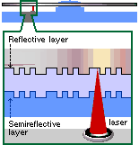
DVD technology
To squeeze all this information onto the CD-sized disc, the designers of the DVD disc made several changes from the compact disc.
First they made pits and lands used to record data and the track spacing nearly half the size of the original CD design.
Then, they made the discs double sided and added another data layer to each side creating a potential for four layers of data per disc.

Slide 107
Optical Storage Types: DVD
Why we need DVD?
Since DVDs can hold large amount of space (several gigabytes), these optical discs were unmistakably built for the heightened home movie experience.
DVDs can hold around two hours of high-quality (with 700 x 480 video resolution) digital video (using MPEG-2 compression), plus digital audio.
One highlight of watching movies in DVDs is the ability to display the natural scene in true widescreen format.
DVDs have also made their way into video game consoles. They enable to have impressive picture quality, realistic PC games…more video into the multimedia productions, which adds more traffic implications over the net.

Slide 108
Difference between CD & DVD disc
CD is usually for computer files, music and pictures. DVD holds more, because they're for movies, animations, etc.
You can use DVD to store data and music if you want
DVDs are produced using the same concept of pits and lands applied to CDs. The important difference incorporated into DVDs are:
More compact packing of the pits/holes: 1.6 microns(10⁻⁶meter) in between for CDs, 0.74 microns for DVDs. (i.e less than half)
Writes data in smaller pits; such that for the same available area, more data can be stored : 0.8 microns for CDs, 0.4 microns for DVDs.
Use of a red laser at a smaller wavelength: 0.78 microns for CDs, 0.65 microns for DVDs.
Moreover, the available data area for DVD disc is larger than the one of CD.
A recordable CD disc has the capacity of 700MB, while a DVD-/+R disc has about 4.7GB.
The DVD is 6 fold increase in storage than the CD.

Slide 109
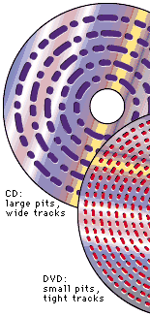
Compared to CD, DVD uses smaller pits and a more closely spaced track. The result is a significant increase in data density. Thus Bits are packed more closely in DVD’s.
Uses smaller pits and lands, reduced track spacing
Can also include another data layer and/or made double sided

Slide 110
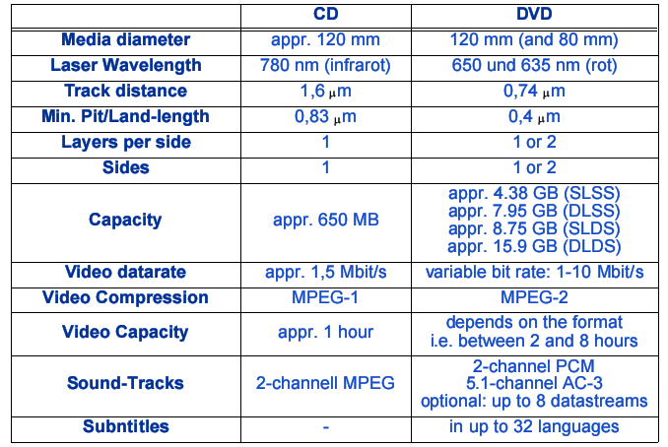
DVD vs CD

Slide 111
DVD Technology
High capacity storage medium
Employs second layer of pits & lands on top of first layer, by adjusting the focus of laser reading both layer is possible
➔ doubles the capacity (8.5 GB)
Two sided
➔doubles the capacity (17 GB)
DVD Formats
Single sided single layer (SS/SL): Can hold 4.7 GB worth of data = 2 hours video
Single sided dual layer (SS/DL) : Can hold 8.5 GB = 4 hours video
Double sided single layer : Can hold 9.4 GB = 4.5 hours video
Double sided dual layer: Can hold 17 GB = 8 hours video

Slide 112
DVD Types
DVD-Video
Released in 1996 by the DVD Forum, DVD-V is used primarily for viewing movies and other visual entertainment, prerecorded on these discs.
They are interactive and contain features that enhance your movie-viewing experience.
Total capacity 17 gigabytes (double-sided)
Another characteristic of DVD-Video is its support for copy-protective measures, such as Regional Protection and CSS (content scrambling system). Such measures were implemented to prevent piracy.
DVD-ROM
Basic technology same as DVD Video, but also includes computer-friendly file formats.
Used to store data

Slide 113
DVD Types
DVD-R
DVD-Recordables, or DVD-Rs, or DVD-dash-Rs, are the first and most popular formats of recordable DVDs. As with CD-R, users can write only once to this disk.
They are expensive at the time and are uncommon discs used for professional needs, as they allow recording of any data;
DVD-R are more available to consumers, but do not allow copying of protected DVDs.
Capacity 4.7 gigabytes.
DVD-RAM
This makes DVD a virtual hard disk, with random read-write access.
Capacity 4.7 gigabyte-per-side.
Can be re-written more than 100,000 times.
The DVD-RAM works like a hard disk.

Slide 114
DVD Types
DVD-RW
Just like CD-RWs, DVD-RW discs change state under a laser for it to be rewritten on. DVD-RWs reach up to 1000 instances of rewritings.
One drawback of these discs is that because they have relatively lower reflectivity and are consequently mistaken as dual-layer DVDs, DVD-RWs are compatible with only around 70% of the players out there.
It is similar to DVD-RAM
Features a sequential read-write access more like a phonograph than a hard disk.
Capacity is 4.7 gigabytes per side.
Can be re-written up to about 1,000 times.
DVD-Audio
The latest audio format with more than double the fidelity of a standard CD.
Because of its much higher capacity, DVDs can make space for much higher audio quality.
However, audio on DVD has never really caught up with audio CDs because people don’t need extremely high-quality music, as they are content even with compressed MP3 formats.

Slide 115
DVD Types
DVD+R and DVD+RW (plus-Rs or plus-RWs)
DVD+R and DVD+RWs provide for:
lossless linking:
no need to re-record a whole disc if only part of it needs updating,
better error handling,
Easy Write or Mount:
twice the maximum writing speed of DVD-RWs
Rainier technology
transforming the disc into an ordinary floppy or hard drive
Compatibility issues: support for DVD+R and DVD+RW may only be found in specialized or high-end hardware and software.

Slide 116
DVD Types
DVD-VR and DVD+VR (DVD Video Recording discs)
Like most DVD discs, DVD-VRs & DVD+VRs were made for videos.
This is taken a step further, though, as these Video Recording formats allow you to create videos on these discs so that they can be edited fully.
Possible Features with the DVD VRs:
adding new video content,
changing menu backgrounds,
inserting chapters,
splitting clips, or
removing unwanted scenes.
Compatibility issues: As for the "minus" versus "plus" formats, the same rule of thumb regarding incompatibility applies: DVD-VRs and DVD+VRs are not usually playable in ordinary DVD players and must be used compatible devices with DVD VRs.

Slide 117

BLU-RAY TECHNOLOGY

Slide 118
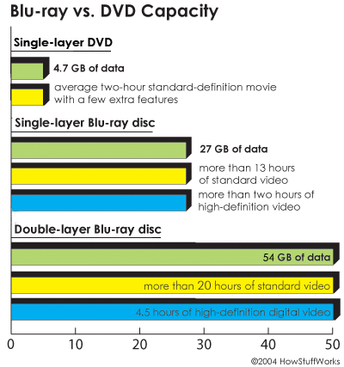
CAPACITY OF BD

Slide 119
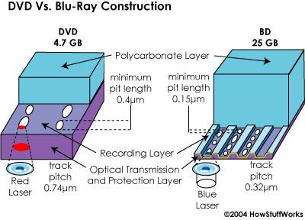
CONSTRUCTION OF BD

Slide 120
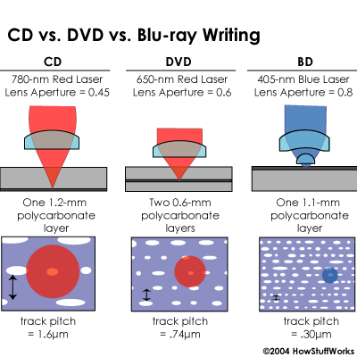
WRITING EFFECT

Slide 121
Retrieval from Multimedia Data

Slide 122
Why Multimedia Information Retrieval System?
Multimedia Information Retrieval System serves as a bridge between the world of authors and the world of readers/users,
That is, writers/producers present a set of ideas in a document using a set of concepts. Then Users seek the MIR system for relevant documents that satisfy their information need.
What is in the Black Box?
The black box is the processing part of the information retrieval system, i,e. indexing and searching
User
Black box
Documents

Slide 123
What is Multimedia Information Retrieval (MIR)?
Multimedia Information Retrieval (MIR) is the process of identifying relevant multimedia data from large corpus that satisfy information need of users
Technically, MIR is defined as a system that deals with representation, storage, organization of, and access to multimedia information items such that users can easily get relevant information that satisfy their information need.

Slide 124
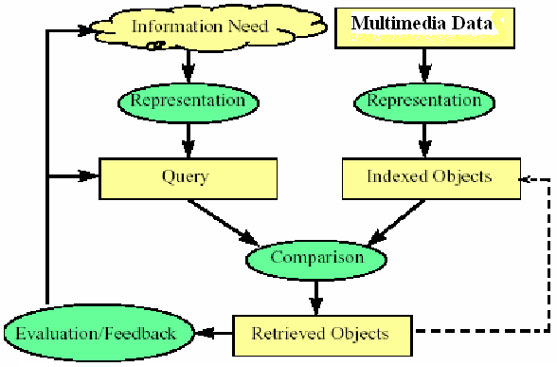
Overview of the Retrieval Process

Slide 125
Retrieval Process ….
It is necessary to define the multimedia database before any of the retrieval processes are initiated
This is usually done by the manager of the database and includes specifying the following
The documents to be used
The operations to be performed on the data
The data model to be used (the data structure and what elements can be retrieved)
The document representation transform the original documents and the information needs and generate a logical view of them

Slide 126
Retrieval Process ….
Once the logical view of the documents is defined, then an index is built
An index is a critical data structure
It allows fast searching over large volumes of data
Different index structures might be used, but the most popular are the inverted file, signature file, suffix tree, etc.
Once the collection is indexed, the retrieval process can then be initiated

Slide 127
Retrieval Process …
The user first specifies an information need in terms of queries which is then represented for searching.
Then with the help of matching module a comparison is made to find documents that are related with users’ query.
Before the retrieved documents are sent to the user, the retrieved documents are ranked according to the likelihood of relevance
The user then examines the set of ranked documents in the search for useful information
Two choices for the user: (i) reformulate query, run on entire collection or (ii) reformulate query, run on result set
At this point, the user might pinpoint a subset of the documents seen as definitely of interest and initiate a user feedback cycle
In such a cycle, the system uses the documents selected by the user to change the query formulation. Hopefully, this modified query is a better representation of the real user need

Slide 128
Subsystems of IR system
The two subsystems of an IR system:
Indexing:
It is the process of organizing index terms identified from multimedia document corpus.
Indexing is used to speed up access to desired information from document collection as per users query
Searching
Searching scans document corpus to find relevant documents that matches users query

Slide 129
Indexing

Slide 130
Indexing Subsystem
Multimedia Corpus
documents
Assign document identifier
Multimedia data
Preprocessing & Segmentation
document IDs
tokens
Feature Extraction
features of tokens
Index File

Slide 131
Building Index file
An index file consists of records, called index entries.
An index file of a multimedia document is a file consisting of a list of index/features and a link to one or more documents that has the index/feature
A good index file maps each feature _{i} to a set of documents D_{i} that contain the index/feature
An index file is list of search terms that are organized for associative look-up, i.e., to answer user’s query:
In which documents does a specified search term appear?
Where within each document does each term appear? (There may be several occurrences.)
There are various options available to organize index file for a collection of documents, :
Decide what data structure and/or file structure to use. Is it sequential file, inverted file, suffix array, signature file, etc. ?

Slide 132
Inverted file for text documents
An indexing mechanism based on sorted list of keywords, with each keyword having links to the documents containing it
Building and maintaining an inverted index is a relatively low cost risk. On a document with n symbols an inverted index can be built in O(n) time
Data to be held in the inverted file includes list of index terms and for each term:
TF_{ij}, number of occurrences of term t_{j} in document d_{i}
DF_{j}, number of documents containing t_{j}
CF_{j}, total frequency of t_{j} in n
n, total number of documents in a collection
….

Slide 133
Construction of Inverted file
An inverted index consists of two files: vocabulary and posting files
A vocabulary file:
stores all of the distinct terms (keywords) that appear in any of the documents and
For each term a pointer to posting file
Records kept for each term j in the vocabulary contains the following:
term j
number of documents in which term j occurs (n_{j})
Total frequency of term j (Collection frequency)
pointer to inverted (postings) list for term j

Slide 134
Postings File
For each distinct term in the vocabulary, stores a list of pointers to the documents that contain that term.
Each element in an inverted list is called a posting, i.e., the occurrence of a term in a document
It is stored as a separate inverted list for each column, i.e., a list corresponding to each term in the index file.
Each list consists of one or many individual postings
Advantage of dividing inverted file:
Keeping a pointer in the vocabulary to the list in the posting file allows:
the vocabulary to be kept in memory at search time even for large text collection, and
Posting file to be kept on disk for accessing to documents

Slide 135
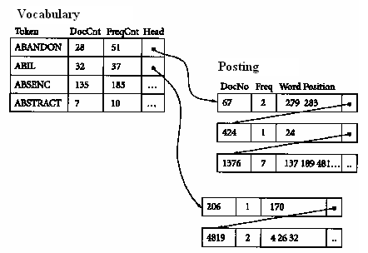
Constructing Inverted index

Slide 136
Inverted File
Documents are organized by the terms they contain
Index Terms | CF | Document ID | TF
Object_1 | 4 | 3 19 22 | 1 2 1
Object_2 | 1 | 5 | 1
Object_3 | 3 | 11 34 | 2 1

Slide 137
Exercise
Given a collection of documents, they are parsed to extract words and these are saved with the Document ID.
I did enact Julius
Caesar I was killed
i' the Capitol;
Brutus killed me.
Doc 1
So let it be with
Caesar. The noble
Brutus hath told you
Caesar was ambitious
Doc 2

Slide 138
Searching
Searching is the process of finding relevant documents that matches users query using similarity measure
There are two basic modules during searching:
first using matching techniques a comparison is made to find documents that are related with users’ query.
There are different matching or similarity measures such as cosine similarity, Euclidean distance, Manhattan distance, string editing, etc.
Then the retrieved documents are ranked using sorting algorithms according to the likelihood of their relevance before presenting to the user
How many sorting algorithms you know from your ‘data structure and algorithm’ course?

Slide 139
Searching Subsystem
query
Segmentation
tokens
Feature Extraction
ranked list
Ranking
features of tokens
relevant multimedia data
Matching
Index File

Slide 140
Matching
Matching is a similarity measure that identifies documents near to users query
What is a Pattern?
An expression that defines a set of index terms (i.e. patterns or representational feature vectors of objects).
Pattern matching:
An index term matches a pattern if it is equal to one of the index terms defined by the pattern.
In other words, the semantics are of disjunction: A pattern P that defines w₁, w₂, …, w_{n} is interpreted as w₁ v w₂ v … v w_{n}
The two well known similarity measures
Euclidean distance & Cosine similarity

Slide 141
Similarity Measures
Euclidean distance:
Cosine Similarity
If X and Y are two vector attributes of data objects, then cosine similarity measure is given by:
where • indicates vector dot product, ||x_{i}|| the length of vector d

Slide 142
Example: Similarity measure
Ex: Find the similarity between documents 1 and 2.
d₁ = (5, 0, 3, 0, 2, 0, 0, 2, 0, 0)
d₂ = (3, 0, 2, 0, 1, 1, 0, 1, 0, 1)
d₁•d₂=5*3+0*0+3*2+0*0+2*1+0*1+0*1+2*1+0*0+0*1= 25
||d₁||=(5*5+0*0+3*3+0*0+2*2+0*0+0*0+2*2+0*0+0*0)^{½} =(42)^{½} = 6.481
||d₂||=(3*3+0*0+2*2+0*0+1*1+1*1+0*0+1*1+0*0+1*1)^{½} = (17)^{½} = 4.12
cos(d₁, d₂ ) = 0.94
Notes:
Chapter 3: Statistics Methods
Co-variance distance
K-L divergence

Slide 143
MIR system evaluation

Slide 144
Why System Evaluation?
It provides the ability to verify and validate the MIR system
Evaluation has two steps:
Verification: helps to check ‘the system is right’; i.e. the first thing we have to evaluate the functionality of the system to correct logical and syntax errors
Validation: helps to check ‘it is the right system’, i.e. it is also crucial to evaluate whether the system is achieving its goal by retrieving relevant documents for users
Develop IR
System
Redesign
Evaluate Its Performance
Identify the gap that needs improvement

Slide 145
Measuring Retrieval Effectiveness
Retrieval of documents may result in:
False negative (false drop): some relevant documents may not be retrieved.
False positive: some irrelevant documents may be retrieved.
A good MIR system should not permit any false drops, but may permit a few false positives.
 | Relevant | Irrelevant
Retrieved | True positive | False positive
Not-retrieved | False negative | True negative
Metrics, like recall & precision are often used to evaluate effectiveness of the system

Slide 146
Measuring Retrieval Effectiveness
 | Relevant | Not relevant
Retrieved | A | B
Not retrieved | C | D
Collection size = A+B+C+D
Relevant = A+C
Retrieved = A+B
Relevant
Relevant +
Retrieved
Retrieved
Not Relevant + Not Retrieved
When is precision important? When is recall important?

Slide 147
Example
Assume that there are a total of 10 relevant document
Result | Relevance | Recall | Precision
1. Doc. 50 | Rel | 10% | 100%
2. Doc. 34 | Not rel | ? | ?
3. Doc. 45 | Rel | 20% | 67%
4. Doc. 8 | Not rel | ? | ?
5. Doc. 23 | Not rel | ? | ?
6. Doc. 16 | Rel | 30% | 50%
7. Doc. 63 | Not rel | ? | ?
8. Doc. 119 | Rel | 40% | 50%
9. Doc. 10 | Not rel | ? | ?
10. Doc. 2 | Rel | 50% | 50%

Slide 148
Precision/Recall tradeoff
Can increase recall by retrieving many documents (down to a low level of relevance ranking),
but many irrelevant documents would be fetched, reducing precision
Can get high recall (but low precision) by retrieving all documents for all queries
1
The ideal
Returns relevant documents but
misses many useful ones too
Precision
Returns most relevant
documents but includes
lots of junk
0
Recall
1

Slide 149
Exercise
Let total number of relevant documents in the collection = 6, compute recall and precision for each cut off point n = 1, 2, 3, …
The search misses one relevant document, and hence never reach 100% recall

Slide 150
F-Measure
One measure of performance that takes into account both recall and precision.
Harmonic mean of recall and precision:
Compared to arithmetic mean, both need to be high for harmonic mean to be high.
What if no relevant documents exist?

Slide 151
E Measure
Associated with Van Rijsbergen
Allows user to specify importance of recall and precision
It is parameterized F Measure. A variant of F measure that allows weighting emphasis on precision over recall:
Value of β controls trade-off:
β = 1: Equal weight for precision and recall (E=F).
β > 1: Weight recall more. It favors recall.
β < 1: Weight precision more. It favors precision.

Slide 152
Single-valued measures
Single value measures may want a single value for each query to evaluate performance
Such measures include:
Mean average precision
R-precision
Etc..

Slide 153
MAP (Mean Average Precision)
Computing mean average for more than one query
Where r_{ij} = rank of the j-th relevant document for Q_{i}; |R_{i}| = #rel. doc. for Q_{i}; n = # test queries
E.g. Assume there are 3 relevant documents for query 1 and 2 relevant documents for query 2, find MAP?
Relevant Docs. retrieved | Query 1 | Query 2
1st rel. doc. | 1 | 4
2nd rel. doc. | 5 | 8
3rd rel. doc. | 10

Slide 154
End of class
Thank you

